Slide 1


Slide 2
CAPSTONE PROJECT
MYNTRA FASHION SALES DATA ANALYSIS
Janani Shree S D

Slide 3
Introduction
Myntra, a leading player in Indian e-commerce, excels as a fashion hub offering diverse products and personalized experiences.
However, in a rapidly evolving market, it faces the challenge of optimizing sales and product offerings. This project aims to leverage data insights to refine Myntra's sales strategy, ensuring it remains competitive and responsive to customer needs.
Through analysis of sales data, predictive modeling, and actionable insights, we strive to enhance Myntra's performance and elevate the shopping experience for its customers.

Slide 4
Business Problem
Myntra aims to boost sales and optimize product offerings amidst intense market competition.
Key challenges include understanding customer preferences, optimizing product assortment, refining pricing strategies, enhancing personalization, and improving inventory management.
By leveraging data-driven insights, Myntra seeks to drive revenue growth, improve customer satisfaction, and maintain its market leadership position.

Slide 5
Approach of Solving the Business Problem
To enhance sales performance and optimize product offerings for Myntra, we employ a systematic, data-driven approach
Understanding the Business Problem - We align with Myntra's objectives and analyze its market positioning and customer demographics to tailor our solutions.
Data Collection - We gather comprehensive sales data from Myntra's database, including product attributes, transactions, demographics, pricing, and discounts.

Slide 6
Approach of Solving the Business Problem
Data Preprocessing - We clean and preprocess the data to ensure accuracy and completeness, handling missing values, duplicates, and standardizing formats.
Exploratory Data Analysis (EDA) - Through descriptive statistics and visualization, we uncover trends and relationships, identifying key drivers of sales performance and customer preferences.
Modeling - Leveraging insights from EDA, we develop predictive models using machine learning algorithms to forecast sales and optimize product recommendations.

Slide 7
Approach of Solving the Business Problem
Evaluation - We assess model performance using metrics and validation techniques, ensuring reliability and generalizability of recommendations.
Our emphasis on data-driven decision-making empowers Myntra to understand customer behavior, identify opportunities, and optimize strategies, ultimately maximizing sales potential and delivering value to customers.

Slide 8
Overview of the Dataset
Data Source Link https://www.kaggle.com/datasets/manishmathias/myntra-fashion-dataset
Size - The dataset contains 5,26,564 entries and 13 columns.
Columns - URL, Product_id, BrandName, Category, Individual_category, category_by_Gender, Description, DiscountPrice (in Rs), OriginalPrice (in Rs), DiscountOffer, SizeOption, Ratings, Reviews.
Data Types - object (string), integer, and float.
Missing Values - DiscountPrice, DiscountOffer, SizeOption, Ratings, and Reviews have missing values.

Slide 9
Data Cleaning
Identifying Missing Values - Utilize pandas' .isnull() or .info() methods to identify columns with missing values.
Numeric Variables - Fill missing values with appropriate measures of central tendency such as mean or median using pandas' .fillna() method.
Categorical Variables - Fill missing values with the mode (most frequent value) or a placeholder value (e.g., "Unknown") using .fillna() method.

Slide 10
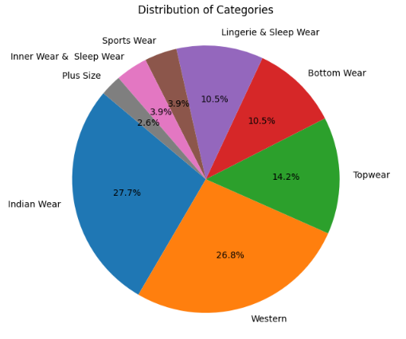
EDA

Slide 11
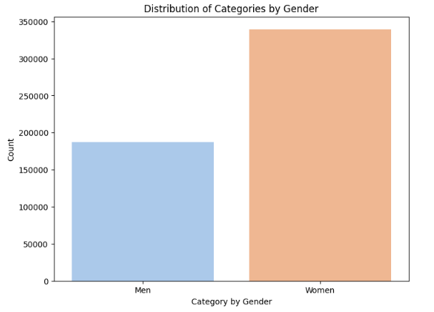
EDA

Slide 12
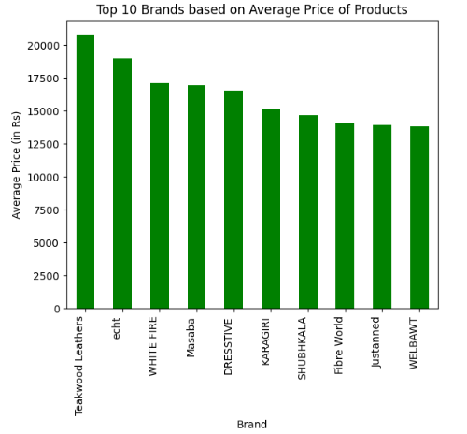
EDA

Slide 13
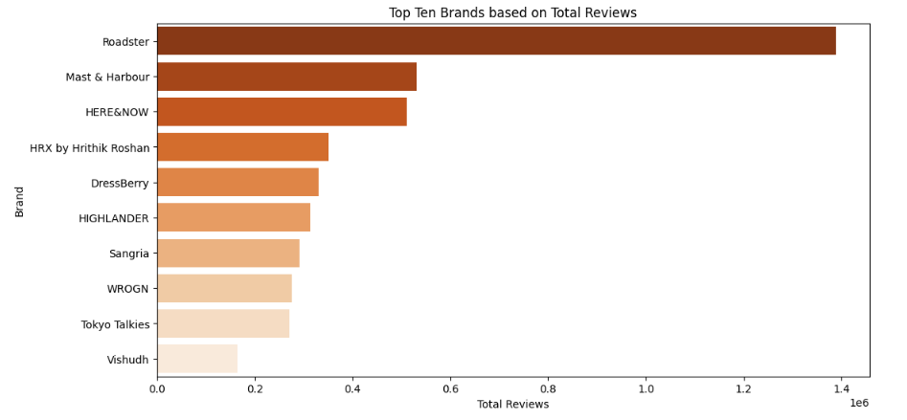
EDA

Slide 14
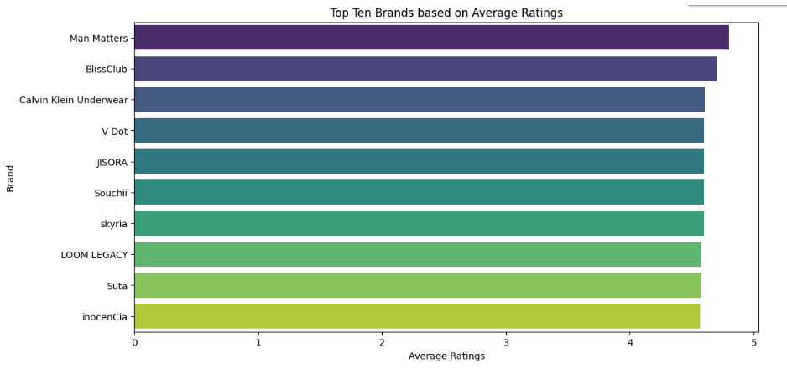
EDA

Slide 15
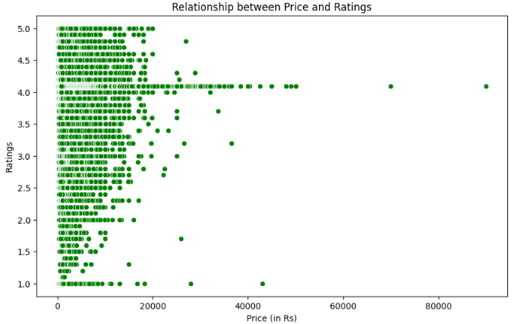
EDA

Slide 16
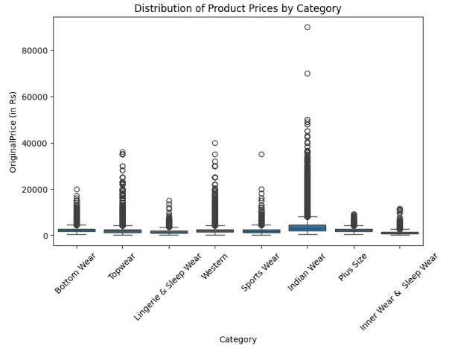
EDA

Slide 17
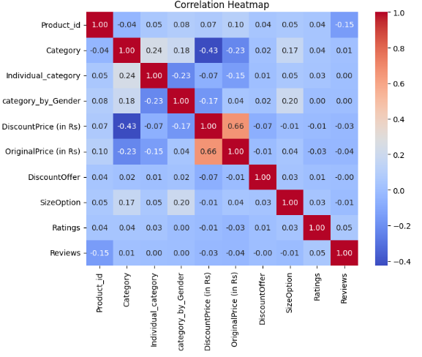
EDA

Slide 18
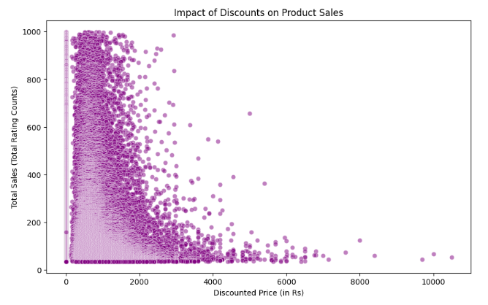
EDA

Slide 19
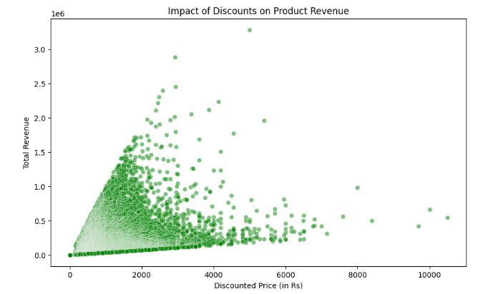
EDA

Slide 20
Recommendation System
Utilizing the Surprise library, collaborative filtering techniques were employed to build a recommendation system for suggesting products to users based on their preferences and browsing history.
The model performance was evaluated using metrics such as root mean squared error (RMSE), providing insights into the accuracy of the recommendations.

Slide 21
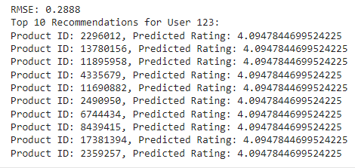
Recommendation System

Slide 22
Model Prediction
Linear Regression
KNN Model
Randam Forest

Slide 23

Linear Regression

Slide 24

KNN Model

Slide 25

Randam Forest

Slide 26
REFERENCE
Github
https://github.com/jananishreeSD/Myntra-Fashion/
Dataset https://www.kaggle.com/datasets/manishmathias/myntra-fashion-dataset

Slide 27
Thank You!!

